Slide 1
gatttool (at least my enhanced version) no longer works.

Slide 2
Steps
Buy and assemble a Raspberry Pi
Buy and install a Wahoo speed sensor on your bike
Load your bike into a trainer stand
Download and install BlueZ
Identify the MAC address of your bikes Wahoo sensor
Complete a virtual flight

Slide 3
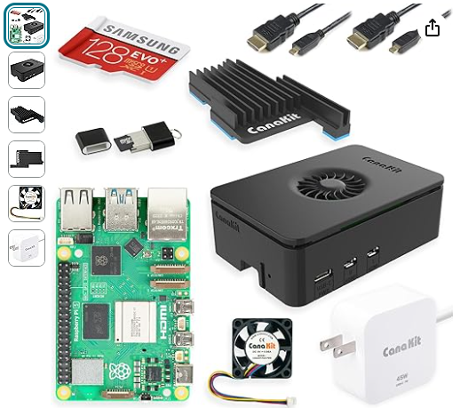
Buy and assemble a Raspberry Pi 5
I ordered a Pi 5 from Amazon and watched this youtube video.

Slide 4



Buy and install a Wahoo speed sensor on your bike’s rear hub
I needed:
Wahoo Speed Sensor Either 53X3.5mm o-ring or 50X2mm o-ring
2032 battery

Slide 5
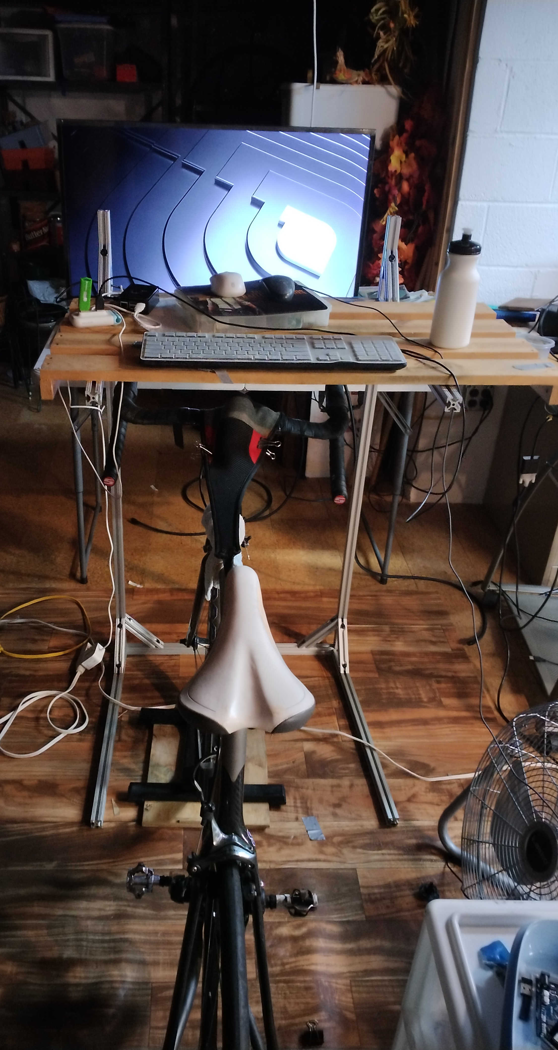
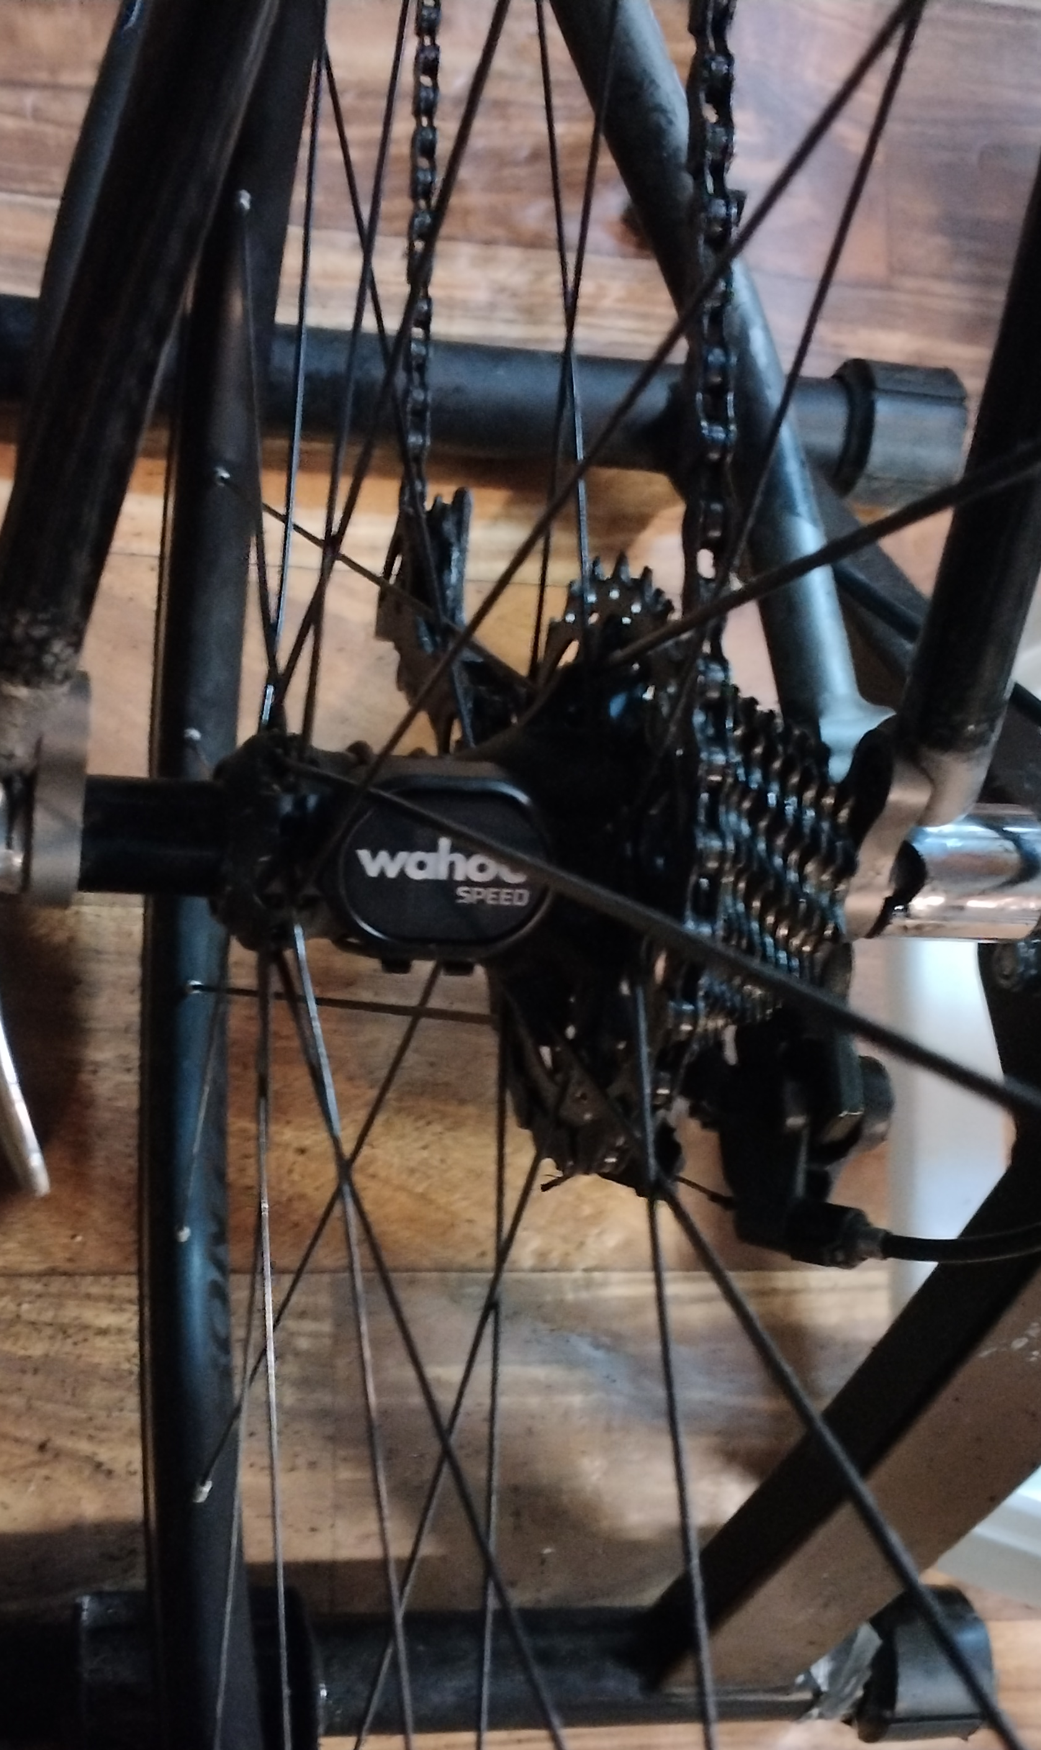
Load your bike into a trainer stand
Rear hub in trainer stand with speed sensor installed.
Blue light should flash if you spin the wheel

Slide 6
Download and install BlueZ
User Space BlueZ Package
To use the latest Bluetooth kernel modules is one important thing, but without support from the user space these modules are useless. For the minimal functionality theÂ bluezÂ package is needed.
bluez-5.66.tar.xz
Make folder in ~/Download named as the archive but without the “.tar.xz”. Move the tar.xz folder into that folder and expand BlueZ
Go to the directory for with expanded archive’s contests and execute the following command:
./configure –enable-deprecated
sudo make
sudo make

Slide 7
Modify BlueZ
within the directory with freshly created, go to attrib directory and replace it version of gatttool.c with todd westley’s version. Again
./configure –enable-deprecated
sudo make
sudo make
But also
sudo cp gatttool /usr/bin/gatttool
Now, /usr/bin/ contains Todd Westley’s version of gatttool

Slide 8
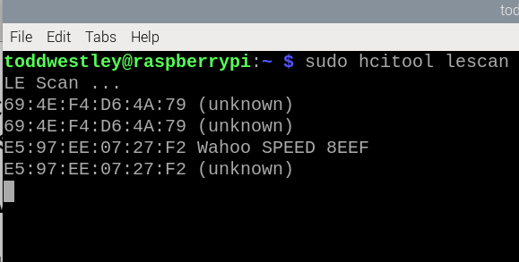
Identify the MAC address of your bikes Wahoo sensor
Spin your rear tire until the blue light begins blinking
Use the command ‘sudo hcitool le scan’ to identify the MAC address of your wheel’s
sensor
MAC address of my sensor

Slide 9
Complete a virtual flight
Update your Raspberry Pi (if available)
Modify FlightGear’s keyboard.xml
Plan you flight using SkyVector
In a new console window, type “sudo -v”
In a new console window, start your version of “./sixthcollectDATA” script
Start pedaling – stop after you see text output from gatttool
Launch FlightGear
In FlightGear hide, hide cockpit, show the HUD check, the joystick configuration
you made need to refresh the joysticks and configure the throttle control
Verify your bike controls throttle
Stop pedalling
In FlightGear, tune the GPS to your destination
Start the engine
Pedal
Fly
After your flight check the sensor’s battery level

Slide 10
Modify FlightGear keyboard.xml
Find keyboard.xml → type “sudo find -name “keyboard.xml”
I redused rudder to (Enter & 0) to 0.05
I changed aileron trim to (
What did I do??

Slide 11
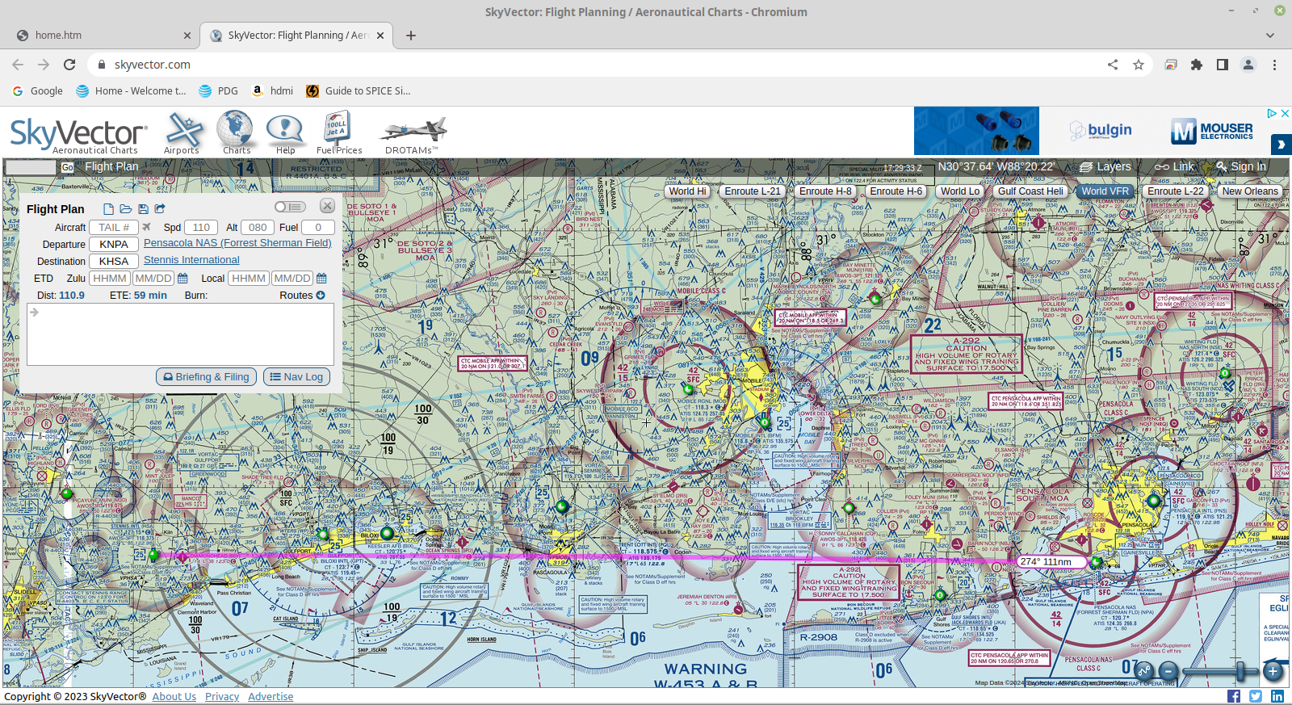
Plan your flight using SkyVector

Slide 12
In FlightGear hide the show the HUD, hide the cockpit, etc.
show the HUD press <h>
hide controls press <c>
check the joystick configuration go to FlightGear file menu
check your fuel

Slide 13
In FlightGear,
stop pedaling
start the aircraft
tune the GPS to your destination
start the engine
resume pedaling

Slide 14
Fly!

Slide 15
After your flight, check the sensor’s battery level using LightBlue on your cell phone

Slide 16
Opportunities to customize things
Give your bike/joystick a name
Select your own speed parameters – see the presentation I gave at the BIAMD
Conference

